Slide 1

Database Searching (FASTA)
Lecture – 8
Department of CSE, DIU

Slide 2
CONTENTS
TP, TN, FP, FN
Selectivity, Sensitivity
Hash Table used in FASTA

Slide 3
1. TP, TN, FP, FN
True Positive, True Negative, False Positive, False Negative

Slide 4
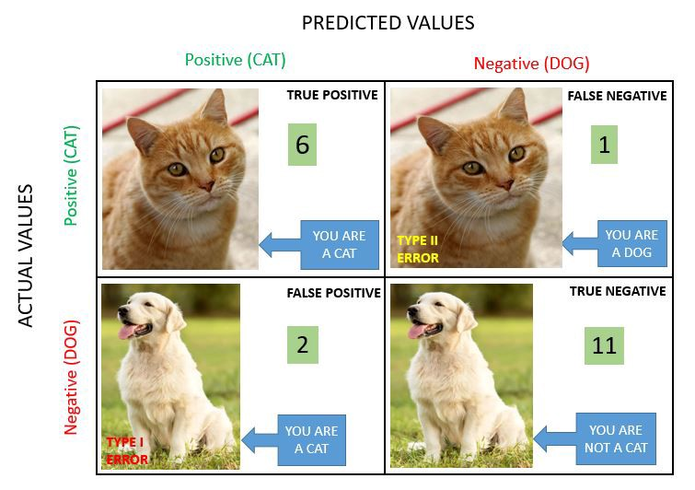

Slide 5
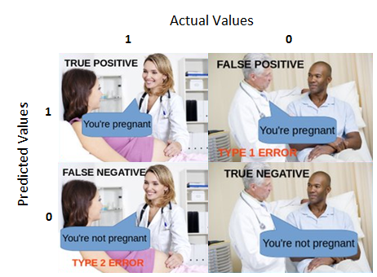

Slide 6
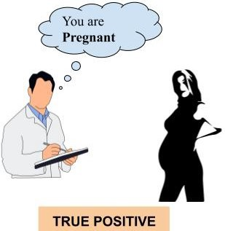
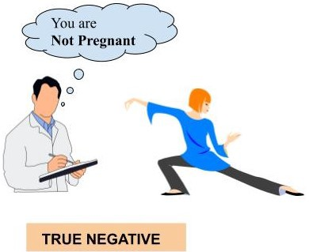
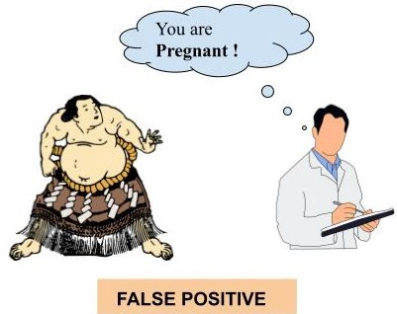
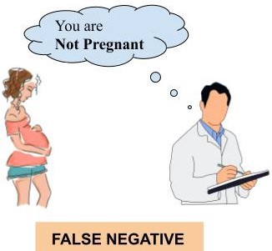

Slide 7

A patient fears that he has Cancer
&
Goes to the doctor for Diagnosis

Slide 8
Possible Scenarios
True Positive
Patient really had cancer
&
Diagnosis came Positive
True Negative
Patient didn’t have cancer
&
Diagnosis came Negative
False Positive
Patient didn’t have cancer
&
Diagnosis came Positive
False Negative
Patient really had cancer
&
Diagnosis came negative

Slide 9
2. Selectivity and Sensitivity
We will learn about calculating selectivity and sensitivity

Slide 10


Selectivity & Sensitivity

Slide 11
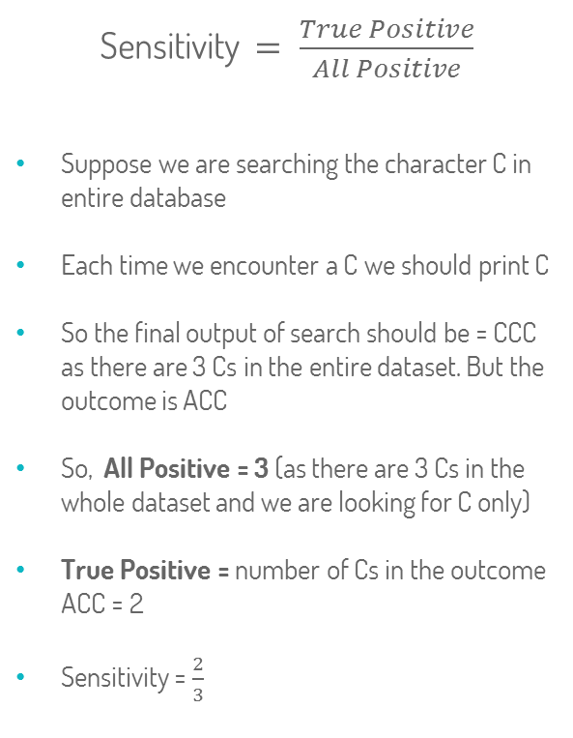
Worked Out Example (Sensitivity)
Dataset
A | G
C | T
G | T
G | C
A | G
C | G
Search Character = C Expected = CCC Outcome = ACC

Slide 12
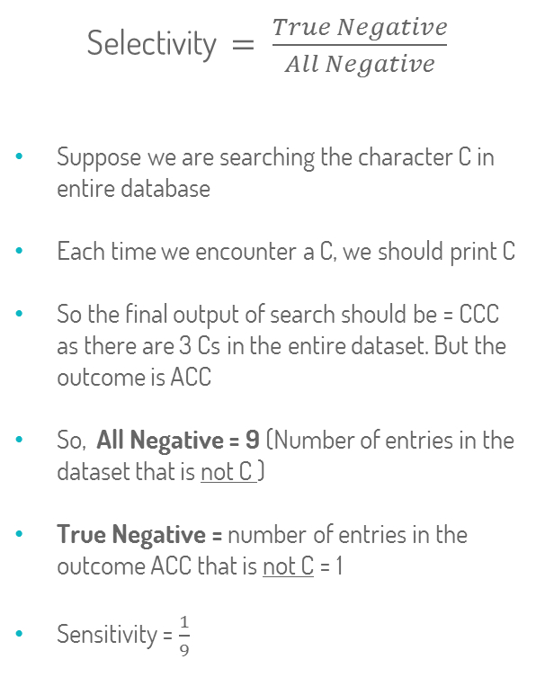
Worked Out Example (Selectivity)
Dataset
A | G
C | T
G | T
G | C
A | G
C | G
Search Character = C Expected = CCC Outcome = ACC

Slide 13
3. Hash Table Used in FASTA
Hash Table Algorithm

Slide 14
Given Data
Query Sequence: JUSTICELEAGUE
Target Sequence: LEAGUEOFASSASINS
Value of K : 1

Slide 15
Step 1 : Build Query Table
1 | 2 | 3 | 4 | 5 | 6 | 7 | 8 | 9 | 10 | 11 | 12 | 13
J | U | S | T | I | C | E | L | E | A | G | U | E

Slide 16
Step 2: Hash Table for Query Sequence
Write all the distinct characters appeared in the Query Sequence Lexicographically and then, beneath that,
write the number of the position in which that letter appeared. There can be multiple occurrences.
A | C | E | G | I | J | L | S | T | U
10 | 6 | 7 9 13 | 11 | 5 | 1 | 8 | 3 | 4 | 2 12

Slide 17
Step 3 : Build Target Table
1 | 2 | 3 | 4 | 5 | 6 | 7 | 8 | 9 | 10 | 11 | 12 | 13 | 14 | 15 | 16
L | E | A | G | U | E | O | F | A | S | S | A | S | I | N | S

Slide 18
Step 4 : Import the Hash Table for Query Sequence
A | C | E | G | I | J | L | S | T | U
10 | 6 | 7 9 13 | 11 | 5 | 1 | 8 | 3 | 4 | 2 12
1 | 2 | 3 | 4 | 5 | 6 | 7 | 8 | 9 | 10 | 11 | 12 | 13 | 14 | 15 | 16
L | E | A | G | U | E | O | F | A | S | S | A | S | I | N | S

Slide 19
Step 5 : Build the Extended Target Table based on Hash Table
A | C | E | G | I | J | L | S | T | U
10 | 6 | 7 9 13 | 11 | 5 | 1 | 8 | 3 | 4 | 2 12
1 | 2 | 3 | 4 | 5 | 6 | 7 | 8 | 9 | 10 | 11 | 12 | 13 | 14 | 15 | 16
L | E | A | G | U | E | O | F | A | S | S | A | S | I | N | S
7 | 5 7 11 | 7 | 7 | -3 7 | 1 3 7 |  |  | 1 | -7 | -8 | -2 | -10 | -9 |  | -13
Entry in Extended Row = Position of the Letter in Hash Table – Position of the Letter in Extended Target Table
Example:
For L, in Extended Target Table, Entry is 7 (8-1) .
Similarly For E, the entries are 5 (7-2), 7 (9-2) and 11 (13-2).

Slide 20
Step 5 : Build Offset Table
Draw a table from the minimum to the maximum entry of the extended target table. Then beneath each entry
number, write down number of times that entry occurred in extended target table. For example, the entry 7
Occurred 6 times and the entry 1 occurred 2 times.
-13 | -12 | -11 | -10 | -9 | -8 | -7 | -6 | -5 | -4 | -3 | -2 | -1 | 0 | 1 | 2 | 3 | 4 | 5 | 6 | 7 | 8 | 9 | 10 | 11
1 |  |  | 1 | 1 | 1 | 1 |  |  |  | 1 | 1 |  |  | 2 |  | 1 |  | 1 |  | 6 |  |  |  | 1

Slide 21
Step 6: Build Pre-Final Table
Start both Query and Target sequence from 0 position.
0 | 1 | 2 | 3 | 4 | 5 | 6 | 7 | 8 | 9 | 10 | 11 | 12 | 13 | 14 | 15
J | U | S | T | I | C | E | L | E | A | G | U | E
L | E | A | G | U | E | O | F | A | S | S | A | S | I | N | S

Slide 22
Step 7 : Build Final Table
Find out the entry number from the offset table, that occurred maximum number of times (Here 7, which occurred
6 times).
After that, add that entry number with the previous starting position of target sequence to get the new starting
Position of Target Sequence (Previous starting position = 0, Then new starting position of target seq becomes 0 + 7 = 7).
0 | 1 | 2 | 3 | 4 | 5 | 6 | 7 | 8 | 9 | 10 | 11 | 12 | 13 | 14 | 15 | 16 | 17 | 18 | 19 | 20 | 21 | 22
J | U | S | T | I | C | E | L | E | A | G | U | E
 |  |  |  |  |  |  | L | E | A | G | U | E | O | F | A | S | S | A | S | I | N | S

Slide 23


